Slide 1
Automate Your Flying Club
Flying Clubs Made Easy
Generate Invoices in Minutes Each Month
https://pilotpartner.net
Notes:
Next Slide will automatically start the video

Slide 2
Notes:
Video will end and automatically go to next slide

Slide 3
About Ken VeArd
Started flying in 1997
SEL/MEL Instrument Rated
Approx. 1,450 hours
Time in: Bonanza, Cessna 414, Cessna Cardinal RG, Beech Sundowner, and more
Creator of Aviation Software since 1997
8+ Years Running Flying Clubs
I am not a CFI & this content is not flight instruction.

Slide 4
Agenda
How Does a Flying Club Really Work?
How Do We Make It Easier?
Scheduling, Flight Time Tracking, Invoices, Payments, MX, Budgets, Reimbursements
Entire Accounts Receivable Automation
Ease The Pain Of Club Volunteers
Deep Dive Of How Automation Works

Slide 5
How a Flying Club Works
A Pilot
Goes For A Flight

Slide 6
How a Flying Club Works
Your Pilot
Goes For A Flight

Slide 7
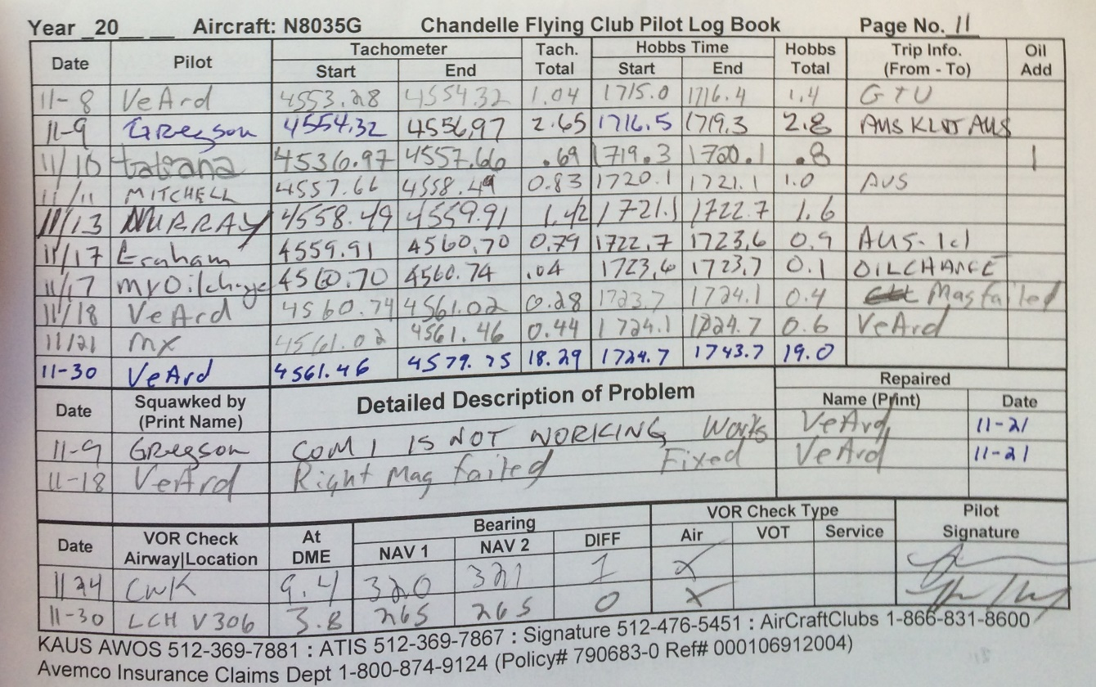
How a Flying Club Works
Writes Times In Logbook
Your Pilot
Goes Flying

Slide 8
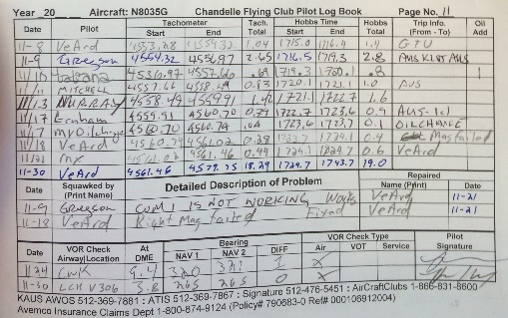
How a Flying Club Works
You Pickup Logbook
Your Pilot
Goes Flying
Writes Times

Slide 9
How a Flying Club Works
You Enter Times On Invoices
Your Pilot
Goes Flying
Writes Times
You Pickup Logbook

Slide 10
How a Flying Club Works
Your Pilot
Goes Flying
You Email Invoices to Members
Writes Times
You Pickup Logbook
You Enter Times

Slide 11
How a Flying Club Works
Your Pilot
Goes Flying
They Send Payment
You Record & Deposit Payment
Writes Times
You Pickup Logbook
You Send Invoices

Slide 12
How a Flying Club Works
Your Pilot
Goes Flying
You Update Budgets
Writes Times
You Pickup Logbook
You Send Invoices
You Receive Payment

Slide 13
How a Flying Club Works
Your Pilot
Goes Flying
You Track MX Records
Writes Times
You Pickup Logbook
You Send Invoices
You Receive Payment
You Update Budgets

Slide 14
How a Flying Club Works
Your Pilot
In the End
You End Up Feeling Like
Goes Flying
Writes Times
You Pickup Logbook
You Send Invoices
You Receive Payment
You Update Budgets
You Track MX Records

Slide 15
How a Flying Club Works
Your Pilot
While Your Pilots
Are Just Out Having Fun
Goes Flying
Writes Times
You Pickup Logbook
You Send Invoices
You Receive Payment
You Update Budgets
You Track MX Records

Slide 16
What is a Flying Club?
Not for Profit or For Profit
Defined Group of People Sharing or Co-Owning 1 or More Plane
Splitting Costs to Save Money
Monthly Dues
Hourly Rate to Fly
Reimbursements for Fuel & Other Expenses
Volunteers To Run The Club
Many Shapes and Sizes

Slide 17
What Does a Flying Club Need To Run?
Schedule Aircraft & Resources
Track Flight Time
Generate Invoices For
Flight Time
Monthly Dues & Other Charges
Collect Payments
Track Budgets & Expenses
Keep Aircraft MX Up to Date

Slide 18
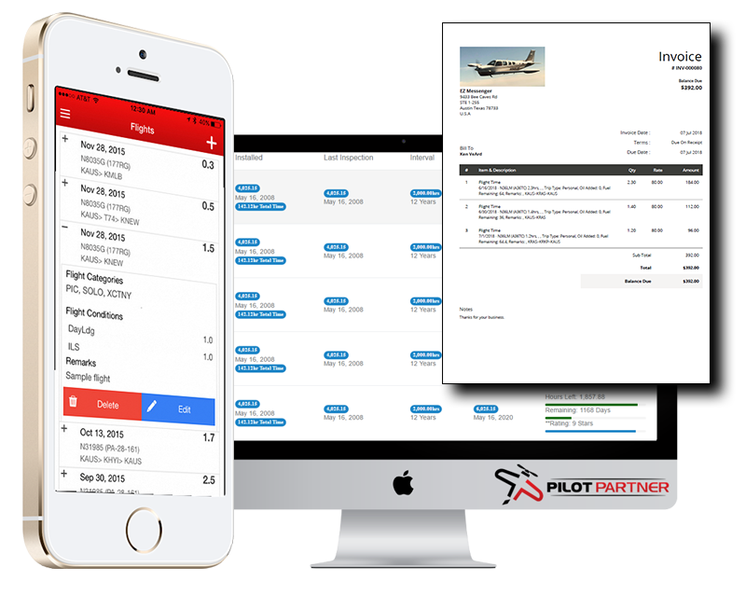
How Do We Automate a Club?

Slide 19
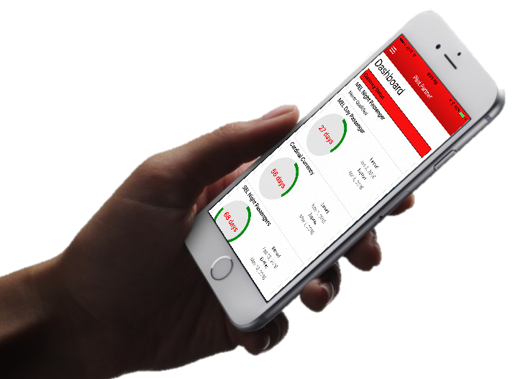
How Pilot Partner Works
Your Pilots
Your Volunteers
Uses Mobile App
Logs Flights As They Happen
Submits Fuel Reimbursements From the App
Views & Pays Invoices From the App
Uses Pilot Partner Web Portal
Reviews Flights & Fuel Reimbursements
Generates Invoices with 1 Button

Slide 20
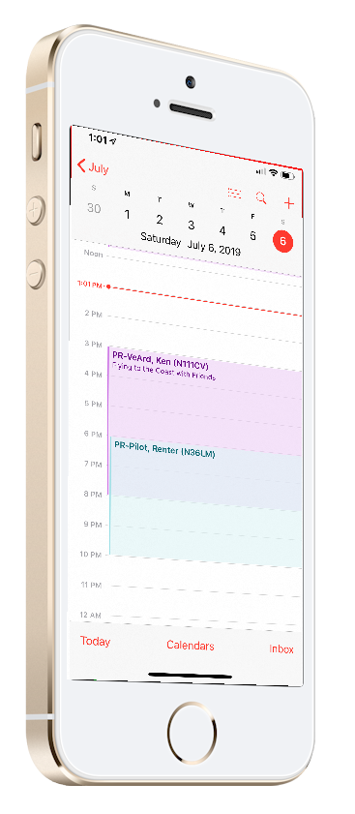
Pilot Aircraft Scheduling
Integration with Google Calendar
Accessible From:
Computers, iPhones, Android Phones, etc.
Different Calendar for Each Aircraft
Make Calendar Entries Like Normal
Schedule Rules & Restrictions
Handles:
Primary Reservations
Backup Reservations
Maintenance Reservations
Reservation Rules

Slide 21
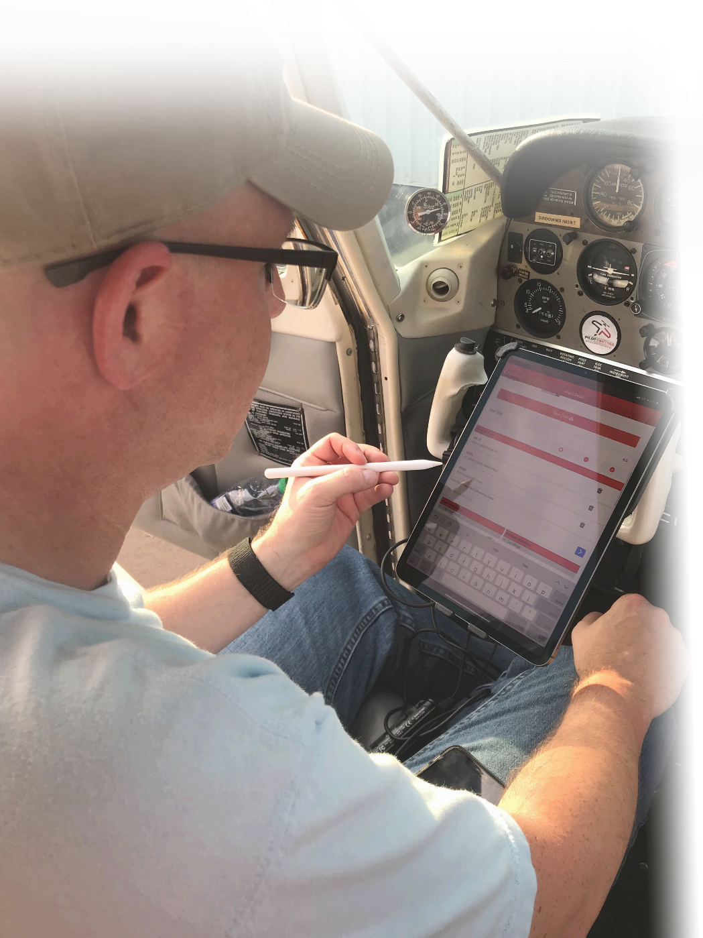
Pilots Logging a Flight
Pilots Should Log Their Flight Before the Next Pilot Flies
Works on iPhone, iPad, Android
Log Before You Leave the Plane
Most Fields are Preselected For You
Enter Hobbs/Tach Start & End
On Average 1 Minute to Log

Slide 22
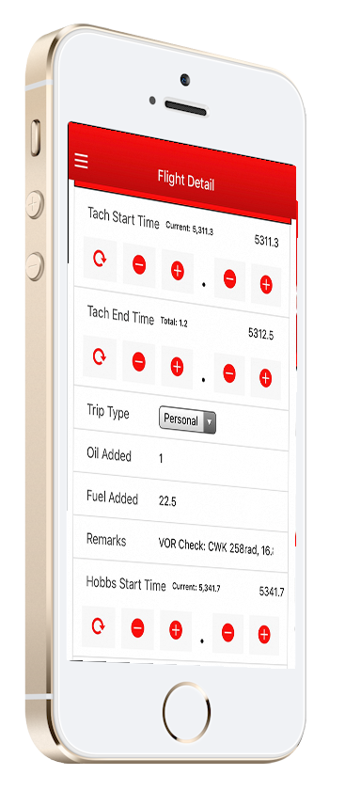
Pilot Examples of Logging a Flight
Easy Entry for Meter Time
Enter Hobbs/Tach Start & End Time
No Math Required for Total Time
Enter Custom Field Information
Create Logs from:
Web Browser on any Computer
iPhone & iPads
Android Phones and Tablets
Best done Immediately After Flight

Slide 23
Pilots Submitting Fuel Reimbursement
Pilots Upload Receipts on iPhone/Android
Pilots Enter
Total Gallons Purchased
Total Fuel Cost
Reimbursement Modes
Fixed Price Per Gallon
Reimburse on Total Price
Adjusted Reimbursement for MX Flights
Credit Automatically Applied on Next Invoice

Slide 24
Pilot Preview of Pending Charges

Slide 25
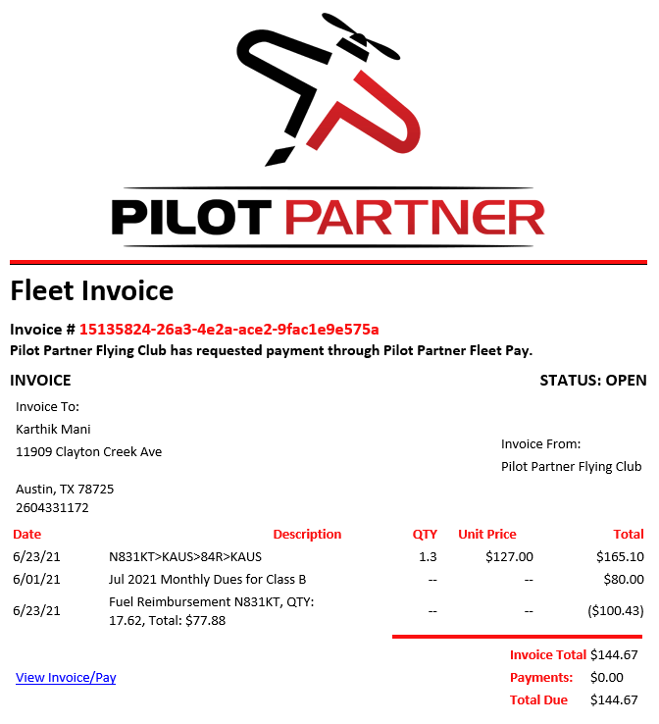
Pilot How Pilots Receive & Pays Invoices
Invoices Generated by Club Admin
Automatic Emails Sent to Members
Pilots View & Pay Invoices in App & In Web Portal
Pilots Can Store Credit Cards & Bank Accounts for Quick Payments
Pilots Pay with Just a Couple of Clicks

Slide 26
From the Club’s Point of View
What is Required From Your Volunteers?
How Much Time Does it Take Each Month?

Slide 27
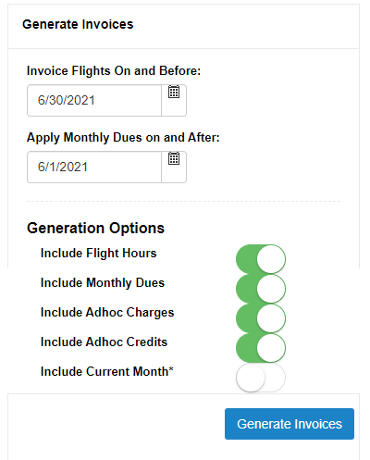
Generating Monthly Invoices With a Click of the Button
When Ready, Click “Generate”
Recommend Review of
Flights
Fuel Reimbursements
Emails Go Out
Members Pay Exact Amount on Invoice
Credit Cards or ACH
Manual Payments

Slide 28
Adhoc Charges & Credits Adjustments on Invoices for Members
Useful For
Initiation Fees
Reimbursements for MX Items
Assessments for All/Some Members
Add to Member Account as Events Occur
Included on Next Invoice
Attach Receipts to Transaction

Slide 29
Options for Paying Invoices
Pilot Partner Fleet Pay
Integrates with Stripe
Free To Enable and Keep
Transaction Fee
0.9% with $6 Max – Bank Transfer
3.4% + $0.50 – Credit Cards
Option to Pass Fee to Member
Manual Payments
QuickBooks Integration
Can Use QuickBooks Payments for Transaction Fee

Slide 30
Integration With QuickBooks
QuickBooks Online Only (Simple Start or Better)
$20-$30/Mo or $215-$300/Yr
Keeps CPA & Accountants Happy
Track Accounts Payable
Automatically Creates QB Invoices
QB Payments
Bank Transfer Available for a Fee
Credit Card Available for Transaction Fee
2 Way Integrated Payments
Pay in QuickBooks
Pay in Pilot Partner

Slide 31
Club Admins Managing Members
Inviting New Members
Enter Email Address
Member Signs Up & Added to Fleet
Control Pilot Groups & Permissions
Removing Members
Disable Schedule Access
Make Inactive
AdHoc Charges
Initiation Fees
Expense Reimbursements
Assessments

Slide 32
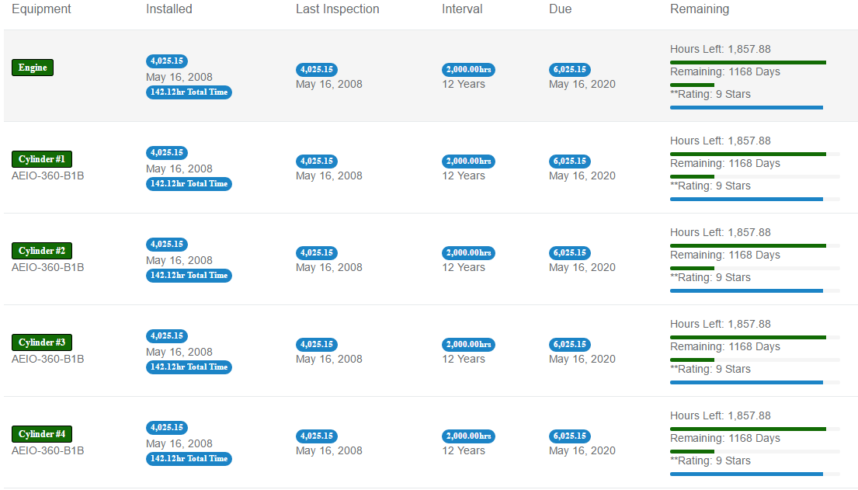
Aircraft MX Tracker

Slide 33
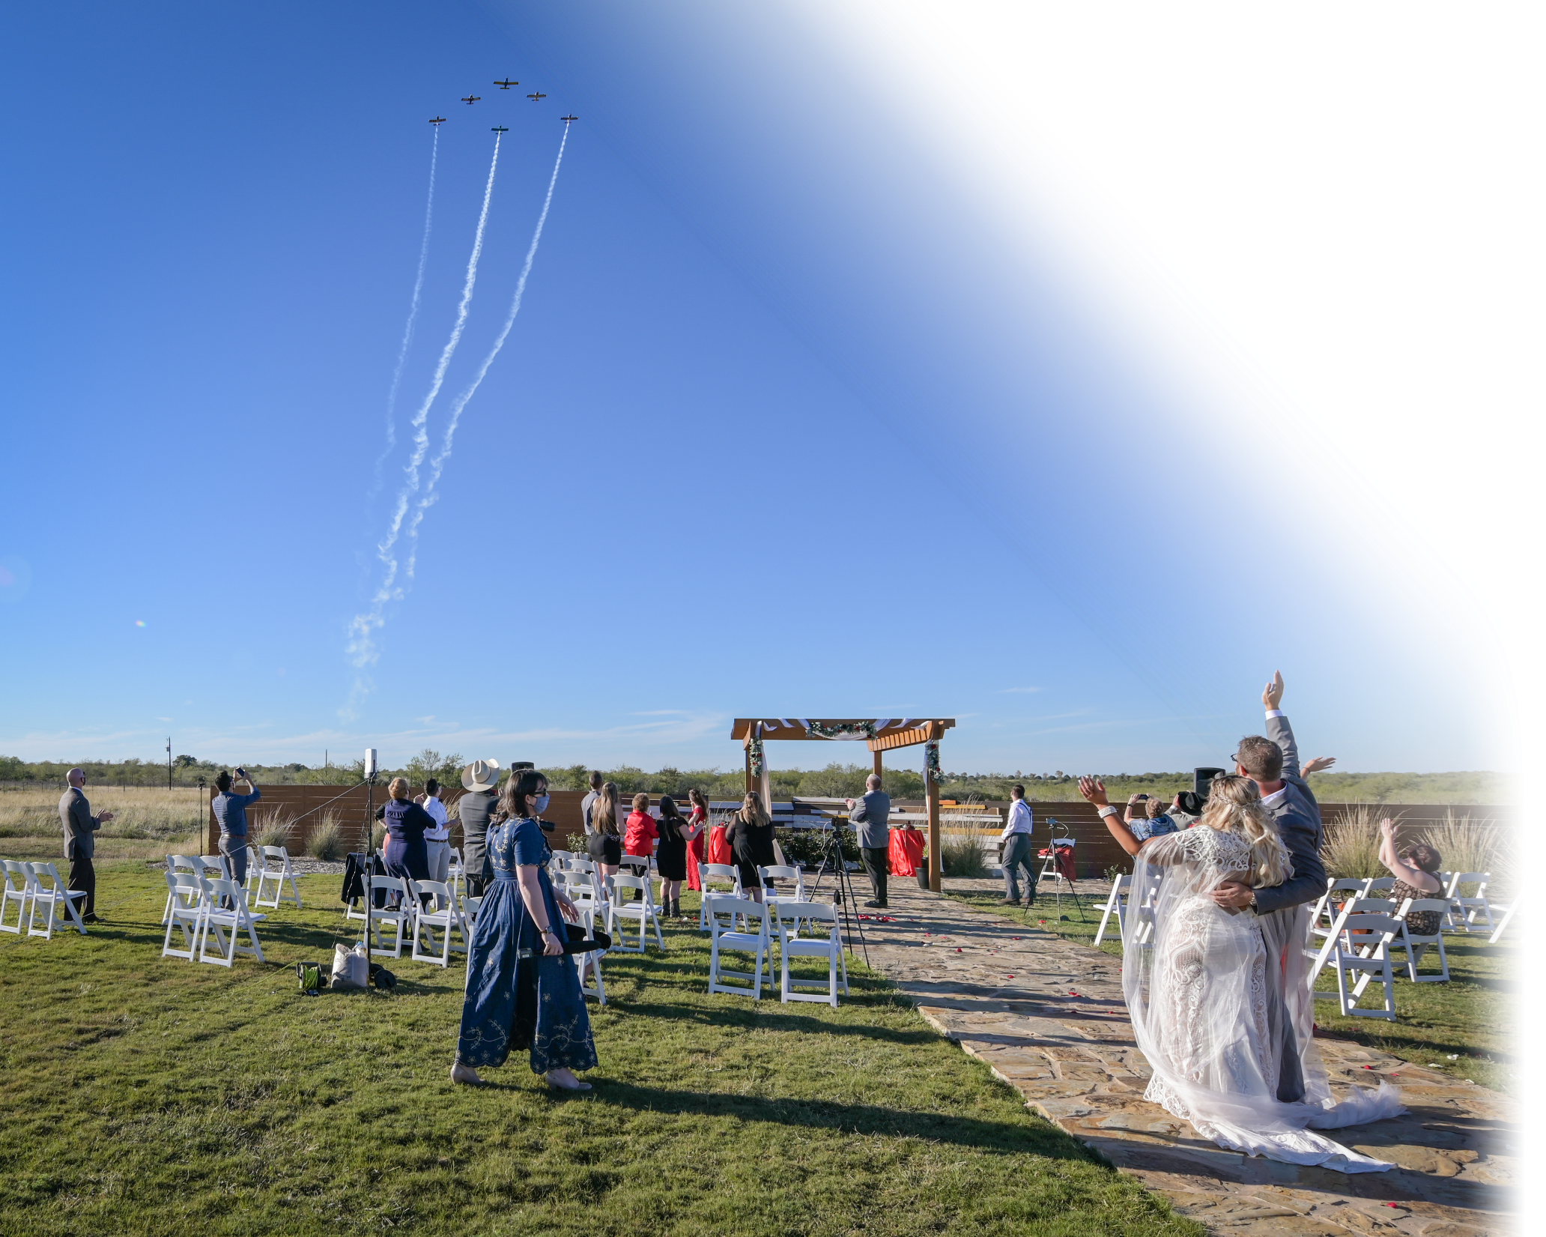
How to Be Successful With An Automated Club?
Notes:
Cover in Detail
Splitting of Monthly Dues vs Hourly
Generating on Time
Control Expenses and Credits, don’t allow MX Officers to go crazy
Coming Up Later in Detail:
Fuel Reimbursements
Budget Details

Slide 34
Establish Procedures That Enable Automation
Monthly Dues to Cover Fixed Costs
Hourly Rates to Cover:
Fuel, MX, Engine Reserve, Oil
Fuel Reimbursement Policy
Generate Monthly Invoices on Time
Make Paying Invoices Easy
Develop Maintainable Budgets
Control Expenses & Credits
Notes:
Cover in Detail
Splitting of Monthly Dues vs Hourly
Generating on Time
Control Expenses and Credits, don’t allow MX Officers to go crazy
Coming Up Later in Detail:
Fuel Reimbursements
Budget Details

Slide 35
Good Habits of A Flying Club Have a Plan to Roll Out Pilot Partner
Make a Plan to Start Your Club With Pilot Partner
Hold a Club Meeting and Discuss the Expectations
Use our Training Materials and Check Lists
Choose the 1st of the Month to Start
Avoid
Having only some members log and not others.
Making Members Log in Two Places for too long
Notes:
Cover in Detail
Splitting of Monthly Dues vs Hourly
Generating on Time
Control Expenses and Credits, don’t allow MX Officers to go crazy
Coming Up Later in Detail:
Fuel Reimbursements
Budget Details

Slide 36
Training Pilots
We Have A Checklist
Put in Each Airplane
Email Blast Your Pilots
How To Guides
Training Videos

Slide 37
Pricing
FREE FOR FLEET
Each Member Pays for Pilot Partner Subscription
$29.95 /Year per Member
SMALL CLUB – 1 Aircraft
Includes FULL Pilot Partner Logbook for all Active Members!
$14.95 /Month
$149.50 /Year
2 - 6 Aircraft
Includes FULL Pilot Partner Logbook for all Active Members!
$12.95 /Month per Aircraft
$129.50 /Year per Aircraft
7 or More Aircraft
$9.95 /Month per Aircraft
$99.50 /Year per Aircraft

Slide 38
Find Pilot Partner
https://PilotPartner.net
support@pilotpartner.net

Slide 39
Additional Information More Details on Good Habits
Notes:
Cover in Detail
Splitting of Monthly Dues vs Hourly
Generating on Time
Control Expenses and Credits, don’t allow MX Officers to go crazy
Coming Up Later in Detail:
Fuel Reimbursements
Budget Details

Slide 40
Good Habits of A Flying Club Pay Exact Invoice Amounts
Only Allow Members to Pay the Exact Amount on an Invoice
Not a Penny more, Not a Penny Less
Avoid
Members Sending In Money Unrelated to an Invoice
Avoid Manual Payments
Notes:
Cover in Detail
Splitting of Monthly Dues vs Hourly
Generating on Time
Control Expenses and Credits, don’t allow MX Officers to go crazy
Coming Up Later in Detail:
Fuel Reimbursements
Budget Details

Slide 41
Good Habits of A Flying Club Review Flight Entries Regularly
Review Flight Entries Often
Mistakes are Easier to Catch the Quicker they are Spotted
Avoid
Only Looking at the End of the Month
Notes:
Cover in Detail
Splitting of Monthly Dues vs Hourly
Generating on Time
Control Expenses and Credits, don’t allow MX Officers to go crazy
Coming Up Later in Detail:
Fuel Reimbursements
Budget Details

Slide 42
Good Habits of A Flying Club Communicate Well With Members
Make it Easy for Members to Discuss Issues
Use a Slack Channel, Email List, Text Thread
Avoid
Members Making a Mistake and it too hard to get help from a club admin
Notes:
Cover in Detail
Splitting of Monthly Dues vs Hourly
Generating on Time
Control Expenses and Credits, don’t allow MX Officers to go crazy
Coming Up Later in Detail:
Fuel Reimbursements
Budget Details

Slide 43
Good Habits of A Flying Club Enforce Log Entries To Be Made Quickly
Make Sure Pilots Enter Their Flights Before the Next Pilot Flies
Log Your Flight then Unbuckle Your Seatbelt
Put a Placard / Sticker in the Airplane
Avoid
Letting is Slide
The Most Common Cause of a Mistake is a Previous Pilot Not Logging Their Flight
Notes:
Cover in Detail
Splitting of Monthly Dues vs Hourly
Generating on Time
Control Expenses and Credits, don’t allow MX Officers to go crazy
Coming Up Later in Detail:
Fuel Reimbursements
Budget Details

Slide 44
Good Habits of A Flying Club Have Pilots Fix Their Errors
Errors Happen, When They Do, the Pilot Should Edit Their Flight
Edit in Web Portal or Mobile App
Fix it Quickly, Some Mistakes can prevent the next pilot from logging correct times.
Avoid
Trying to fix it for them. Remember, this is the Pilot’s Logbook too, you can’t just edit their logbook.
Notes:
Cover in Detail
Splitting of Monthly Dues vs Hourly
Generating on Time
Control Expenses and Credits, don’t allow MX Officers to go crazy
Coming Up Later in Detail:
Fuel Reimbursements
Budget Details

Slide 45
Handling Mistakes No Pilot is Perfect, Mistakes Happen
Pilot Partner Validation on Start & End Times
Pilots Who Forget To Log
Blank Entry Created
Admin Can Assign it to Member
Member can Log it after the fact
Credits and Charges Added to Invoice

Slide 46
Getting Started
Create Your Fleet
Add Your Aircraft
Run Aircraft MX Wizard
Configure Pilot Groups
Set Monthly Dues & Aircraft Rates
Configure Rules & Settings
Connect QuickBooks*
Connect Stripe Account*
We Can Help You Get Setup!

Slide 47
How Much Work Ongoing Is Required?
1st of Month:
Review (If Needed)
Pending Reimbursements
Review Pending Transactions
Click Generate Invoices
Enter Budget Expenses
Log Member Reimbursements
New Member Entry

