Slide 1
Automate Your Flying Club
Invoice & Track Automatically
Spend more time Flying than Working
https://pilotpartner.net
Notes:
Next Slide will automatically start the video

Slide 2
Notes:
Video will end and automatically go to next slide

Slide 3
About Ken VeArd
Started flying in 1997
SEL/MEL Instrument Rated
Approx. 1,200 hours
Time in: Bonanza, Cessna 414, Cessna Cardinal RG, Beech Sowndowner, and more
Author of Aviation Software since 1997
6+ Years Running Flying Clubs
I am not a CFI & this content is not flight instruction.

Slide 4
Agenda
How Does a Flying Club Really Work?
How Do We Automate?
Track Time, Invoices, MX, Budgets, Reimbursements
Automation from the Pilot’s Point of View
How to Get Started
Integration with QuickBooks
How Much Does it Cost?

Slide 5
What is a Flying Club?
Not for Profit or For Profit
Defined Group of People Sharing or Co-Owning 1 or More Plane
Splitting Costs to Save Money
Monthly Dues
Hourly Rate to Fly
Reimbursements for Fuel & Other Expenses
Volunteers To Run The Club
Many Shapes and Sizes

Slide 6
How a Flying Club Works
A Pilot
Goes For A Flight

Slide 7
How a Flying Club Works
Your Pilot
Goes For A Flight

Slide 8
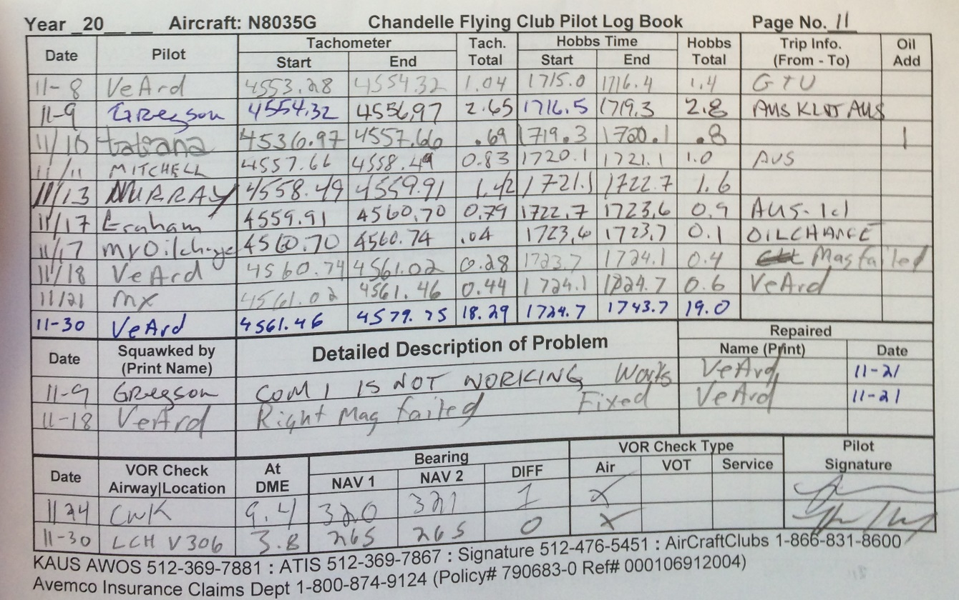
How a Flying Club Works
Writes Times In Logbook
Your Pilot
Goes Flying

Slide 9
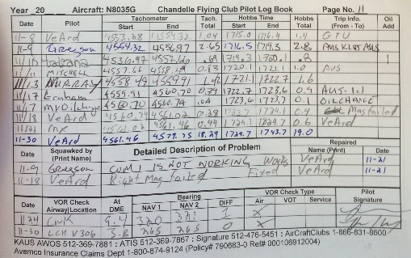
How a Flying Club Works
You Pickup Logbook
Your Pilot
Goes Flying
Writes Times

Slide 10
How a Flying Club Works
You Enter Times On Invoices
Your Pilot
Goes Flying
Writes Times
You Pickup Logbook

Slide 11
How a Flying Club Works
Your Pilot
Goes Flying
You Email Invoices to Members
Writes Times
You Pickup Logbook
You Enter Times

Slide 12
How a Flying Club Works
Your Pilot
Goes Flying
They Send Payment
You Record & Deposit Payment
Writes Times
You Pickup Logbook
You Send Invoices

Slide 13
How a Flying Club Works
Your Pilot
Goes Flying
You Update Budgets
Writes Times
You Pickup Logbook
You Send Invoices
You Receive Payment

Slide 14
How a Flying Club Works
Your Pilot
Goes Flying
You Track MX Records
Writes Times
You Pickup Logbook
You Send Invoices
You Receive Payment
You Update Budgets

Slide 15
How a Flying Club Works
Your Pilot
In the End
You End Up Feeling Like
Goes Flying
Writes Times
You Pickup Logbook
You Send Invoices
You Receive Payment
You Update Budgets
You Track MX Records

Slide 16
How a Flying Club Works
Your Pilot
While Your Pilots
Are Just Out Having Fun
Goes Flying
Writes Times
You Pickup Logbook
You Send Invoices
You Receive Payment
You Update Budgets
You Track MX Records

Slide 17
What Does a Flying Club Need To Run?
Track Flight Time
Generate Invoices For
Flight Time
Monthly Dues & Other Charges
Collect Payments
Schedule Aircraft & Resources
Track Budgets & Expenses
Keep Aircraft MX Up to Date

Slide 18
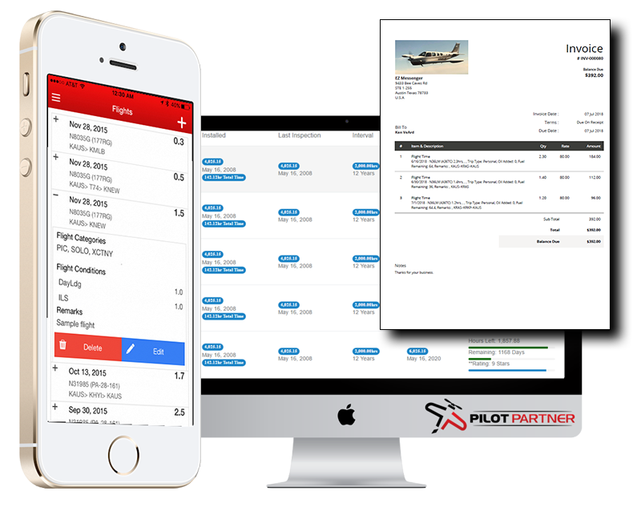
How Do We Automate a Club?

Slide 19
Establish Procedures That Enable Automation
Monthly Dues to Cover Fixed Costs
Hourly Rates to Cover:
Fuel, MX, Engine Reserve, Oil
Fuel Reimbursement Policy
Generate Monthly Invoices on Time
Make Paying Invoices Easy
Develop Maintainable Budgets
Control Expenses & Credits
Notes:
Cover in Detail
Splitting of Monthly Dues vs Hourly
Generating on Time
Control Expenses and Credits, don’t allow MX Officers to go crazy
Coming Up Later in Detail:
Fuel Reimbursements
Budget Details

Slide 20
Tracking Budgets
Common Budgets
Aircraft Maintenance (MX) (Monthly & Hourly)
Single Budget vs Budget Per Aircraft
Engine Reserve (Hourly)
Fuel Purchases (Hourly)
Offset by Fuel Reimbursements
Operational Expenses (OPX) (Monthly)
Capital Improvements (Ad-Hoc Charges)
Aircraft Loans (Monthly)

Slide 21
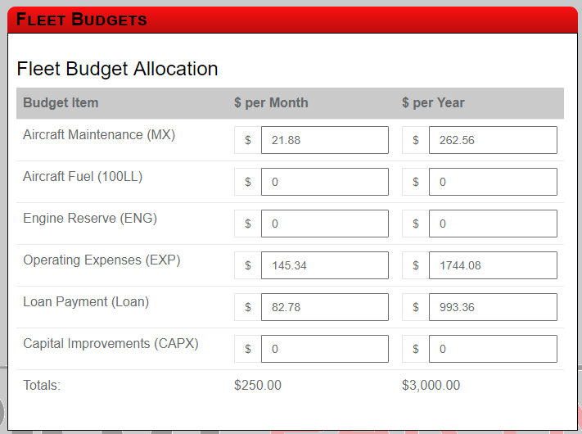
Monthly Dues
MX – Fixed Cost Annual Fee
OPX
Hangar
Insurance
Office Expense
Loan Payment*

Slide 22
Hourly Rates
Based on Expected # Hours per Year
Example: 200hrs/year
Engine Reserve
Maintenance
Fuel (If Wet Rate)

Slide 23
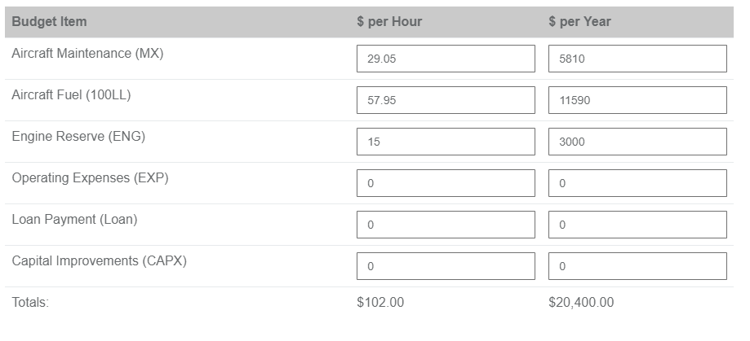
Hourly Rates
Based on Expected # Hours per Year (200hrs)
Engine Reserve
Maintenance
Fuel (If Wet Rate)

Slide 24
Monthly Invoices
Invoice Monthly & Not Per Flight
Rentals Invoice Per Flight
High Level of Workload to Maintain
Members Fly More Invoiced Monthly
Integrate with QuickBooks to Send Emails
Payments Made in QB or Pilot Partner
Two Way Payments Sync with QB
View Invoices in Pilot Partner Web & App

Slide 25
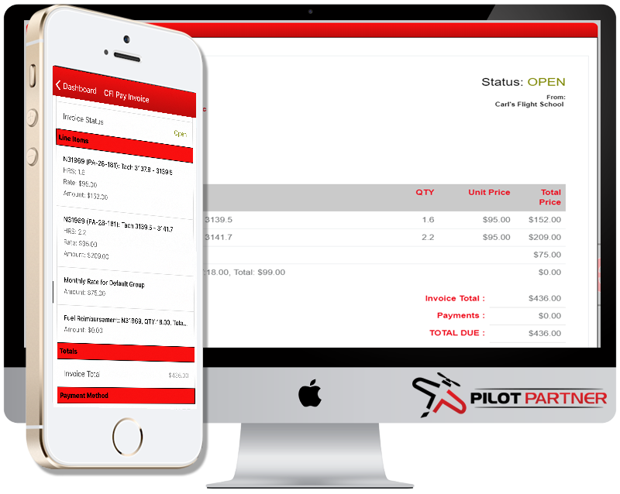
Monthly Invoices

Slide 26
Paying Invoices
QuickBooks Integration
ACH – Direct Bank Transfer. 0.0% Fee!
Credit Cards – Transaction Fee
Pilot Partner Fleet Pay
Integrates with Stripe
Free To Enable and Keep
Transaction Fee
3.4% + $0.50
Option to Pass Fee to Member
Track Payments Manually

Slide 27
Paying Invoices
QuickBooks Integration
ACH – Direct Bank Transfer. 0.0% Fee!
Credit Cards – Transaction Fee
Pilot Partner Fleet Pay
Integrates with Stripe
Free To Setup, Enable and Keep
Transaction Fee
3.4% + $0.50
Option to Pass Fee to Member

Slide 28
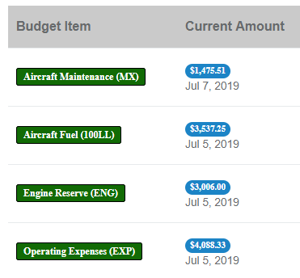
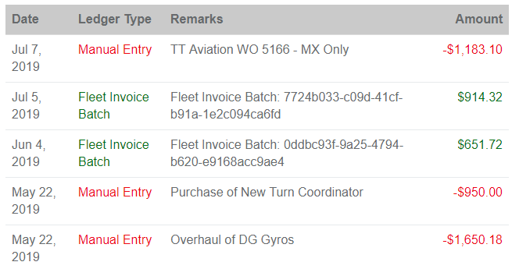
Tracking Budget Expenses
Budget Expenses Are:
Paid Directly by the Club (Manual Entry)
Paid By Club Member & Reimbursed

Slide 29
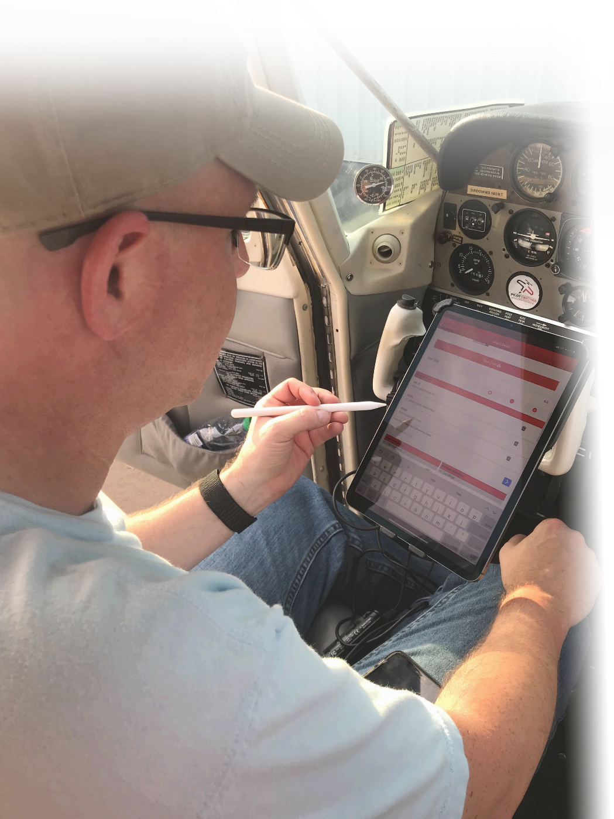
How Do The Pilots Do This? Examples From our Own Flying Club
All Pilots Get Full Access to Pilot Partner Electronic Logbook
Pilots Track Time as They Log Their Flight
Fuel Reimbursements Submitted with Flight
Entries Are Logged, Reviewed and Invoiced Monthly
Pilots Get to See Pending Charges

Slide 30
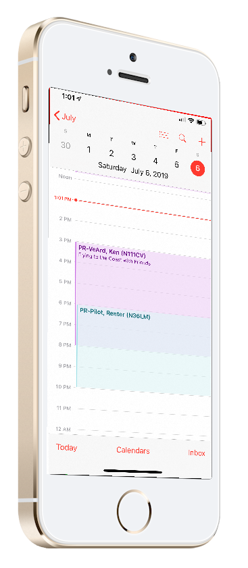
1. Scheduling Flights Examples From our Own Flying Club
Integration with Google Calendar
Accessible From:
Computers, iPhones, Android Phones, etc.
Different Calendar for Each Aircraft
Make Calendar Entries Like Normal
Handles:
Primary Reservations
Backup Reservations
Maintenance Reservations
Reservation Rules

Slide 31
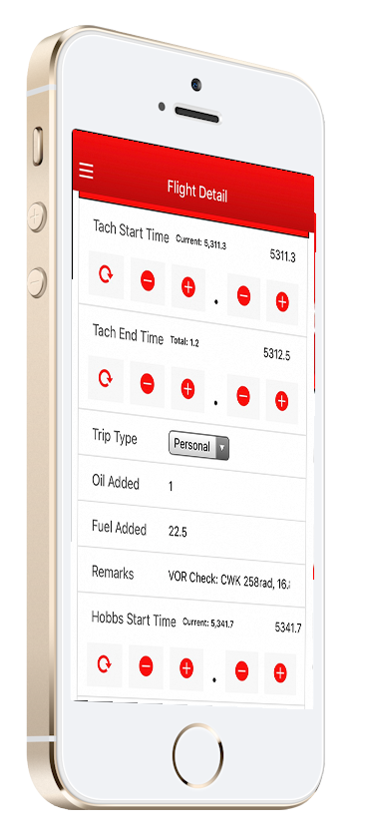
2. Tracking Flight Time Examples From our Own Flying Club
Pilots Log Their Flights
Enter Hobbs/Tach Start & End Time
Enter Custom Field Information
Create Logs from:
Web Browser on any Computer
iPhone & iPads
Android Phones and Tablets
Best done Immediately After Flight

Slide 32
2. Tracking Flight Time Examples From our Own Flying Club

Slide 33
3. Preview Pending Charges Examples From our Own Flying Club

Slide 34
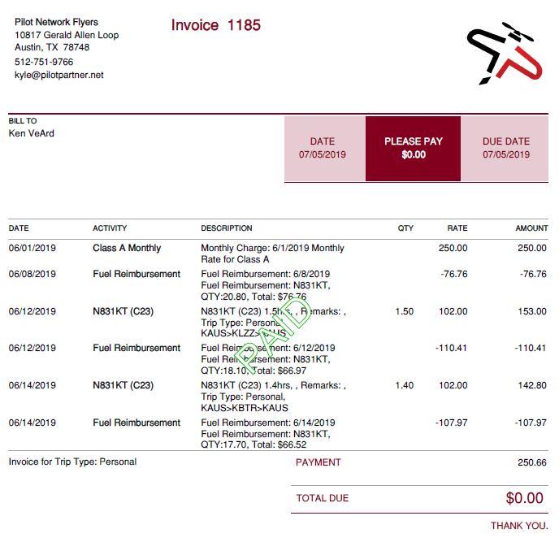
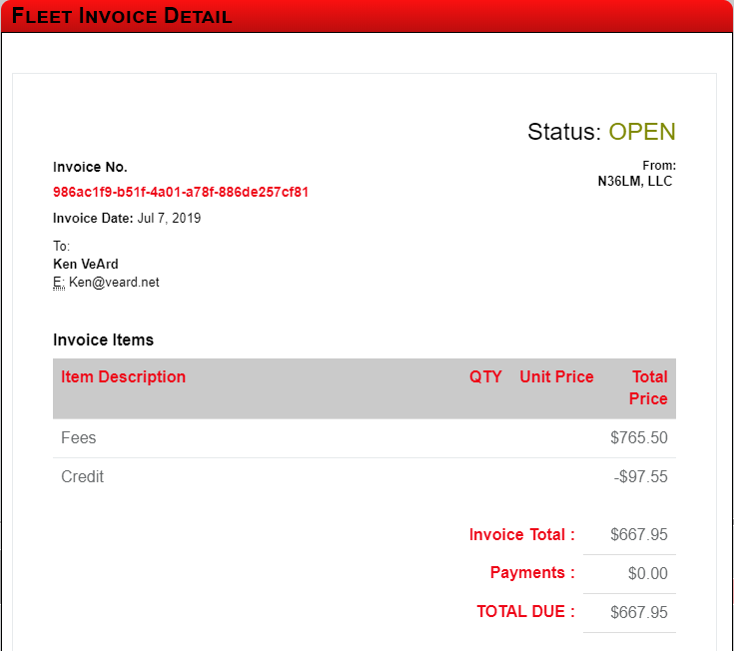
4. Invoices Examples From our Own Flying Club
Invoices Generated Monthly
Received from QuickBooks or Pilot Partner

Slide 35
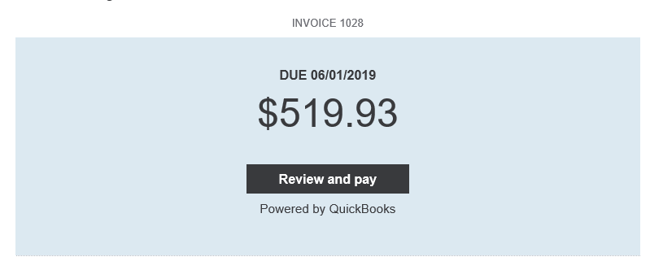
5. Pay Invoice Examples From our Own Flying Club
Pay Via QuickBooks Portal
Pay with Pilot Partner Fleet Pay
Email Sent From QuickBooks
Fleet Pay From Web or APP

Slide 36
Integration With QuickBooks
QuickBooks Online Only (Simple Start or Better)
$20/Mo or $215/Yr
Automatically Creates QB Invoices
QB Payments
ACH is Free. Transfer to Bank in 5 Business Days
Credit Card Available for Transaction Fee
2 Way Integrated Payments
Pay in QuickBooks
Pay in Pilot Partner

Slide 37
Fuel Reimbursements
Pilots Upload Receipts on iPhone/Android
Pilots Enter
Total Gallons Purchased
Total Fuel Cost
Reimbursement Modes
Fixed Price Per Gallon
Reimburse on Total Price
Adjusted Reimbursement for MX Flights

Slide 38
Getting Started
Create Your Fleet
Add Your Aircraft
Run Aircraft MX Wizard
Configure Pilot Groups
Set Monthly Dues & Aircraft Rates
Configure Rules & Settings
Connect QuickBooks*
Connect Stripe Account*
We Can Help You Get Setup!

Slide 39
How Much Work Ongoing Is Required?
1st of Month:
Review (If Needed)
Pending Reimbursements
Review Pending Transactions
Click Generate Invoices
Enter Budget Expenses
Log Member Reimbursements
New Member Entry

Slide 40
Training Pilots
We Have A Checklist
Put in Each Airplane
Email Blast Your Pilots
Training Videos

Slide 41
Handling Mistakes No Pilot is Perfect, Mistakes Happen
Pilot Partner Validation on Start & End Times
Pilots Who Forget To Log
Blank Entry Created
Admin Can Assign it to Member
Member can Log it after the fact
Credits and Charges Added to Invoice

Slide 42
Pricing
FREE FOR FLEET
Each Member Pays for Pilot Partner Subscription
$29.95 /Year per Member
SMALL CLUB – 1 Aircraft
Includes FULL Pilot Partner Logbook for all Active Members!
$14.95 /Month
$149.50 /Year
2 - 6 Aircraft
Includes FULL Pilot Partner Logbook for all Active Members!
$12.95 /Month per Aircraft
$129.50 /Year per Aircraft
7 or More Aircraft
$9.95 /Month per Aircraft
$99.50 /Year per Aircraft

Slide 43
Find Pilot Partner
https://PilotPartner.net
support@pilotpartner.net
Special Discount:
Promo-Code: OshLog19
Buy 1 Year get 1 Year Free!

